Slide 1

Tailor Shop Management System
Group No : C2-05
Presented By:
Md Younus Hossain Ahsan (190104131)
Samia Afrin (190104132)
Md Abid Rahman (190104141)

Slide 2

Proposal
Motivation :
It is very difficult to store the necessary information like customer's information, order details etc. using register copy .
There is a risk of losing any information and data using register copy .
It is very difficult to search any previous information and data using register copy
It is also very difficult to organized all the works and maintain the delivery date using register copy .
By using database, all those problems mentioned above can be solved and handled easily and smartly .
Prospective Clients for Software :
Any types of Tailor like Smart Tailor Shop .

Slide 3
Searching Options Descriptions
Customer_ID : By using Customer_ID , all the information of a customer can be found out .
Phone_Number : By using Phone_Number , all the information of a customer can also be found out .
Order_ID : By using Order_ID , all the information of an order can be found out .
Dress_ID : By using Dress_ID , all the information of a dress like Dress_name , cost can be found out .

Slide 4
Features
All the information and data of a customer can stored with proper security .
Any information and data can be searched and found anytime .
No risk to lose any information and data .
The pending and delivered order list can be seen separately .
All the works related management system of a tailor can be done easily and quickly .

Slide 5
Project Structure
Table 1 : Customer_Info
Attributes Name | Description | Type | Length
Customer_ID | Unique id for each customer | varchar | 9
Customer_Name | Name of a customer | varchar | 25
Phone_Number | Phone number of a customer | varchar | 11
Gender | Gender of a customer | varchar | 6
Address | Contact address of a customer | varchar | 25
Number_of_order | Number of order of a customer | int | ---
Primary Key : Customer_ID

Slide 6
Project Structure (2)
Table 2 : Order_List
Attributes Name | Description | Type | Length
Customer_ID | Unique id for each customer | varchar | 9
Order_ID | Unique id for each order | int | ---
Order_Date | Order receiving date | date | ---
Delivery_Date | Dress delivering date | date | ---
Dress_ID | Unique id for each type of dress | varchar | 6
Cost | Dress preparing cost | int | ---
Discount | Discount rate on the cost | int | ---
Primary Key : Order_ID
Foreign Key : Customer_ID, Dress_ID

Slide 7
Project Structure (3)
Table 3 : Dress_Category
Attributes Name | Description | Type | Length
Dress_ID | Unique id for each type of dress | varchar | 9
Dress_Name | Name of a Dress | varchar | 15
Cost | Dress preparing cost | int | ---
Primary Key : Dress_ID

Slide 8
Project Structure (4)
Table 4 : Deliveried_Dress
Attributes Name | Description | Type | Length
Customer_ID | Unique id for each customer | varchar | 9
Order_ID | Unique id for each order | int | ---
Order_Date | Order receiving date | date | ---
Delivery_Date | Dress delivering date | date | ---
Dress_ID | Unique id for each type of dress | varchar | 6
Cost | Dress preparing cost | int | ---
Discount | Discount rate on the cost | int | ---
Primary Key : Order_ID
Foreign Key : Customer_ID, Dress_ID

Slide 9
Project Structure (5)
Table 5 : Order_List
Attributes Name | Description | Type | Length
Serial_Number | Serial Number of the Dress list | int | ---
Order_ID | Unique id for each order | int | ---
Neck | A part of measurement | double | ---
Chest | A part of measurement | double | ---
Height | A part of measurement | double | ---
Wrist | A part of measurement | double | ---
Hip | A part of measurement | double | ---
Primary Key : Serial_Number
Foreign Key : Order_ID

Slide 10
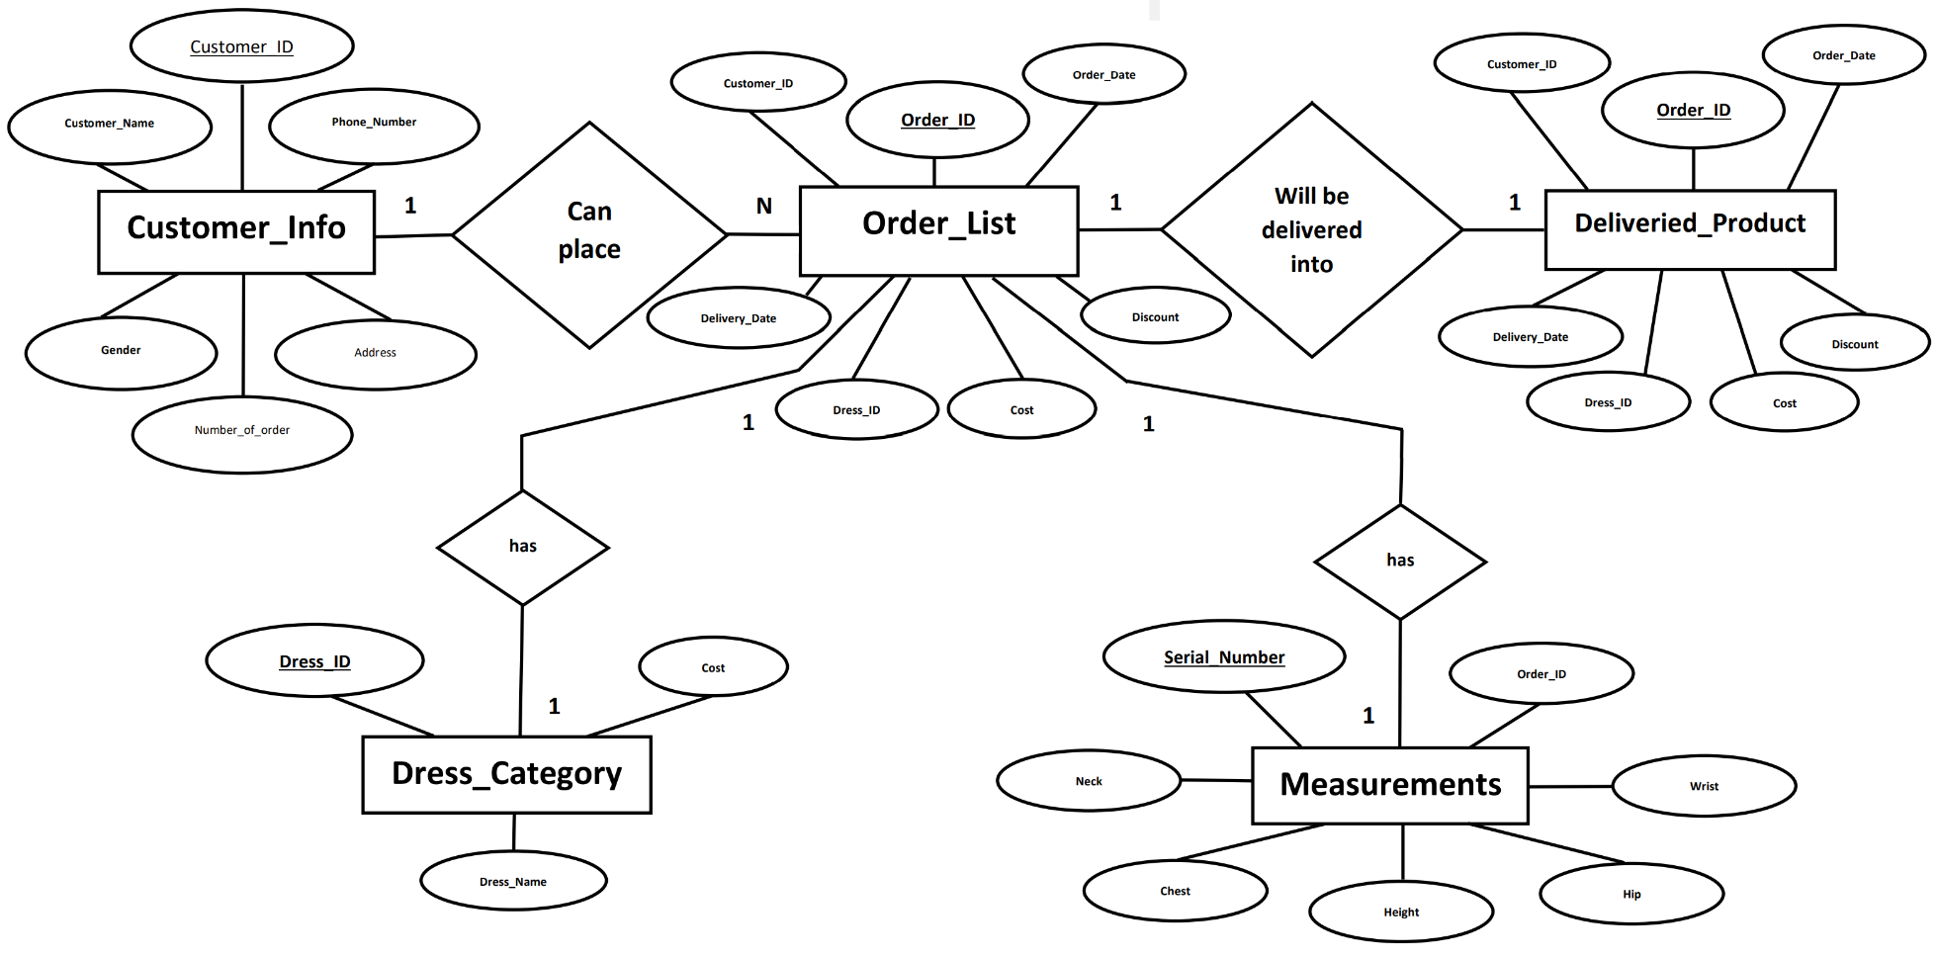
Entity Relationship Diagram

Slide 11
Requirements
Language :
Java (Java Swing)
SQL Database
Software :
Netbeans IDE
SQL Server Management Studio

Slide 12
Future Plan
We, the developers have a lot of schemes regarding this software :
More features will be included in the upcoming version of this software with the demands of the users.
If any errors or any faults are found , we will correct them.

Slide 13
Conclusion
This software is developed with the above mentioned scenario by us. Actually, this software has been developed to remove all the difficulties to store, search and get data anytime . Sometimes, losing any information and data may happen using register copy . But using database, all the information and data can be stored with proper security . Hopefully, this software will be helpful for all the users .

Slide 14
Thank You

